Slide 1
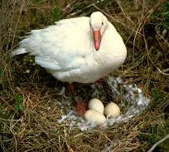
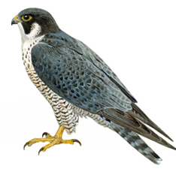
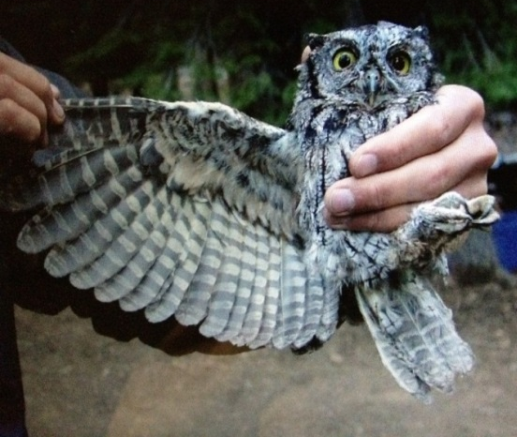
AVES
These are warm-blooded animals and have a four-chambered heart.
They lay eggs.
Can not change the temperature of their body according to the environmental temperature
There is an outside covering of feathers, and two forelimbs are modified for flight.
They breathe through lungs.
All birds fall in this category.

Slide 2
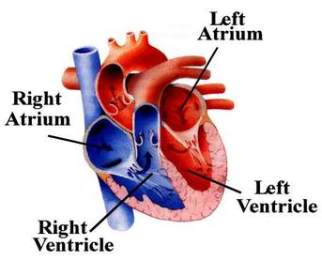
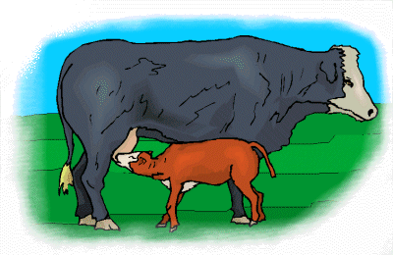
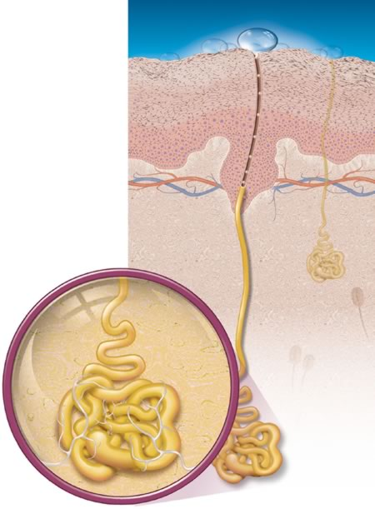

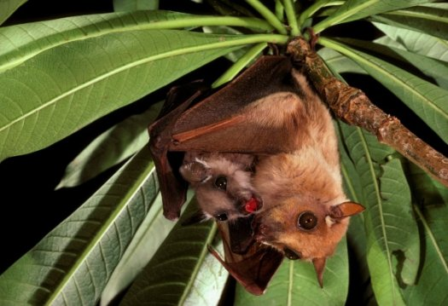
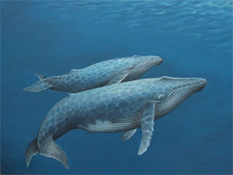
MAMMALIA
Mammals are warm-blooded animals with four-chambered hearts.
They have mammary glands for the production of milk to nourish their young.
Their skin has hairs as well as sweat and oil glands.
Most mammals familiar to us produce live young ones.

Slide 3

AVES
These are warm-blooded animals and have a four-chambered heart.
They lay eggs.
Can not change the temperature of their body according to the environmental temperature
There is an outside covering of feathers, and two forelimbs are modified for flight.
They breathe through lungs.
All birds fall in this category.

Slide 4
MAMMALIA
Mammals are warm-blooded animals with four-chambered hearts.
They have mammary glands for the production of milk to nourish their young.
Their skin has hairs as well as sweat and oil gland .
Most mammals familiar to us produce live young ones.

Slide 5


NOMENCLATURE
Looking at the Great Biodiversity,
there arises a need for SYSTEMATIC NAMING of living organisms.

Slide 6






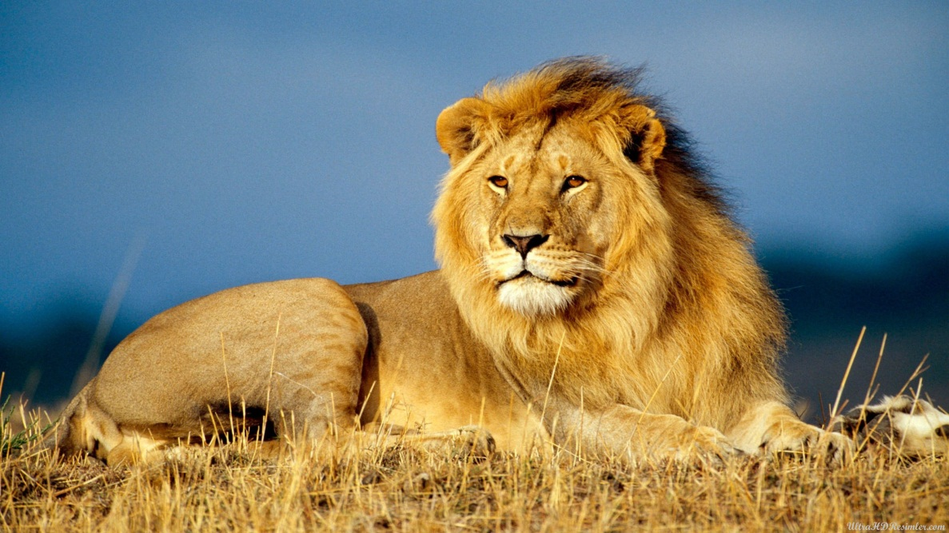
NOMENCLATURE
It would be difficult for people speaking or writing in DIFFERENT LANGUAGES to know when they are talking about the SAME ORGANISM.
For example : LION is called as
In Spanish : León
In Hindi : Sher
In German : Löwe
In Japanese : Raion

Slide 7








NOMENCLATURE
For example : The scientific name of LION is Panthera leo
This problem was resolved by agreeing upon a ‘Scientific Name’ for organisms that would be used the world over.
The Scientific Name for an organism is Unique and thus Can Be Used To Identify It Anywhere In The World.

Slide 8
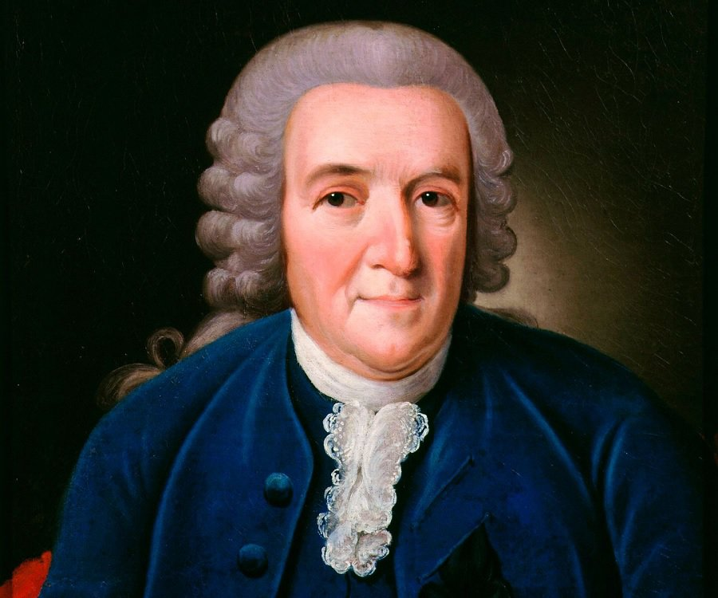
NOMENCLATURE
The system of scientific naming or nomenclature we use today was introduced by Carolus Linnaeus in the Eighteenth Century.

Slide 9

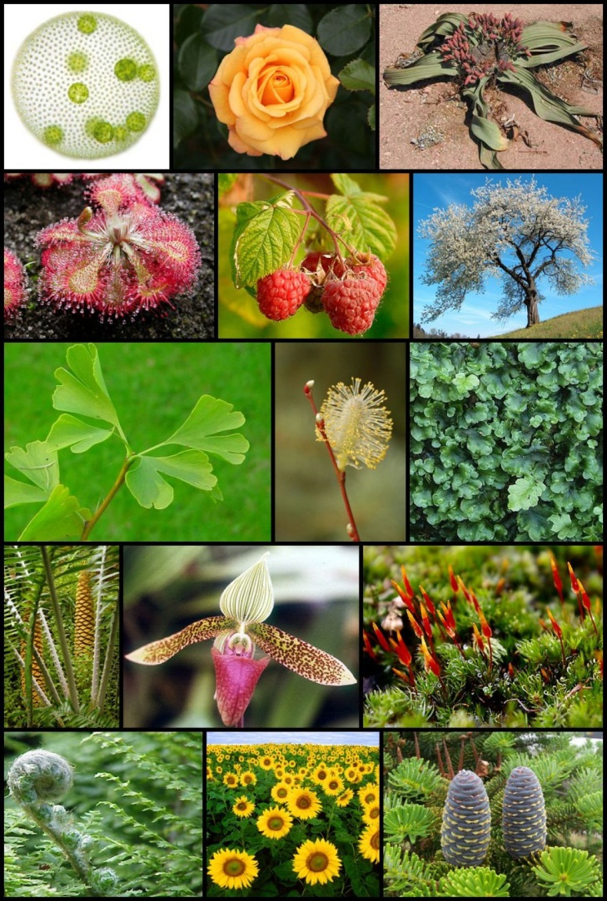
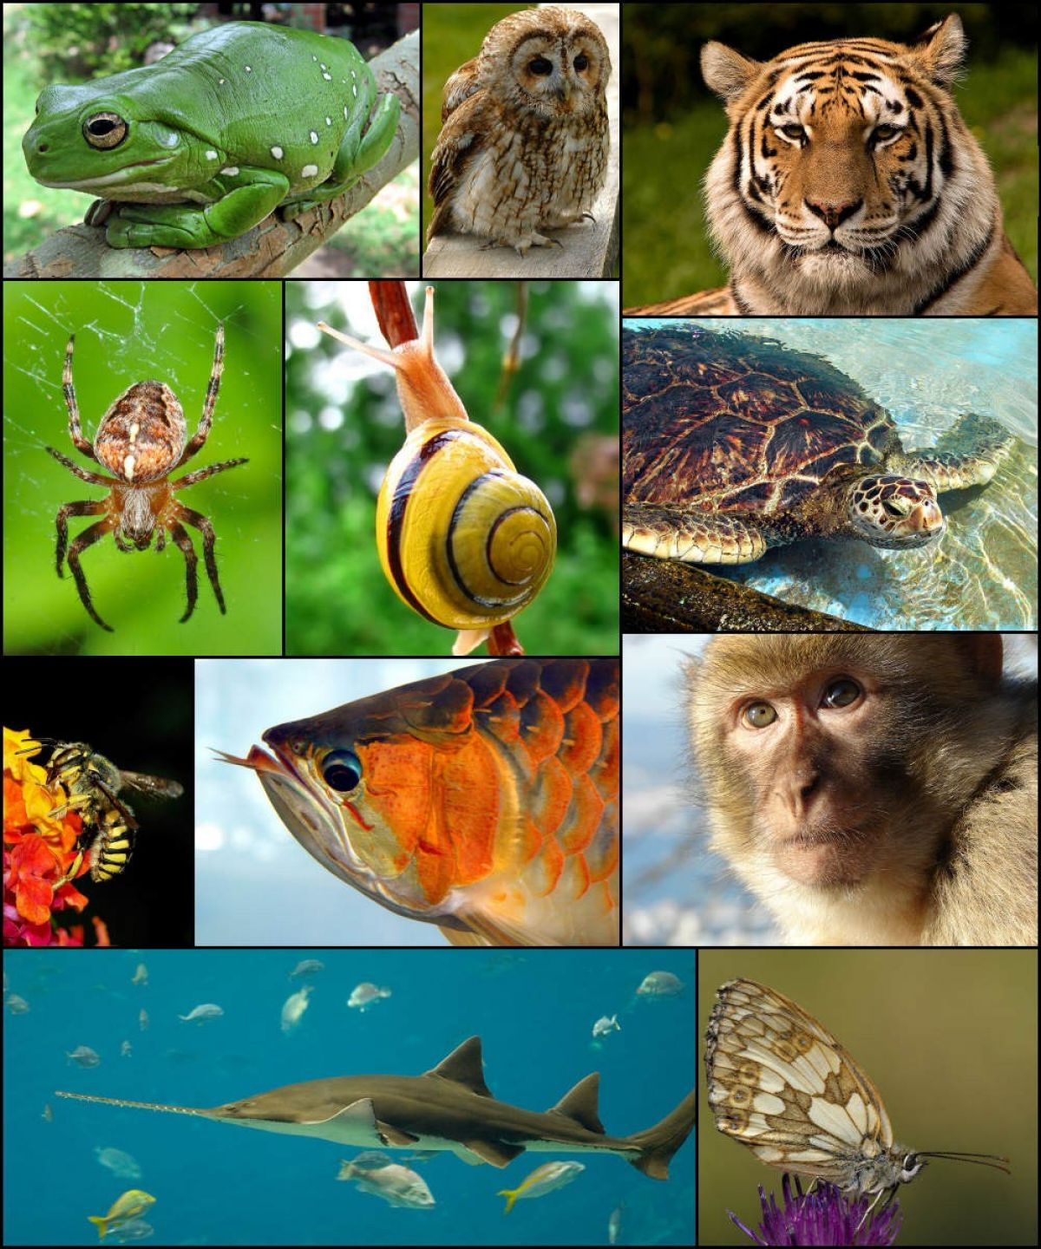
NOMENCLATURE
The SCIENTIFIC NAME of an organism is the result of the PROCESS OF CLASSIFICATION which puts it along with the organisms it is most related to.

Slide 10


NOMENCLATURE
We DO NOT LIST OUT THE WHOLE HIERARCHY OF GROUPS which the species belongs to.
For example :
Kingdom : Animalia
Phylum : Chordata
Class : Mammalia
Order : Carnivora
The world over, it has been agreed that BOTH THESE NAMES will be used in LATIN FORMS.
Family : Felidae
Genus : Panthera
Species : leo
Instead, we limit ourselves to writing the NAME OF THE GENUS and SPECIES of that particular organism.

Slide 11

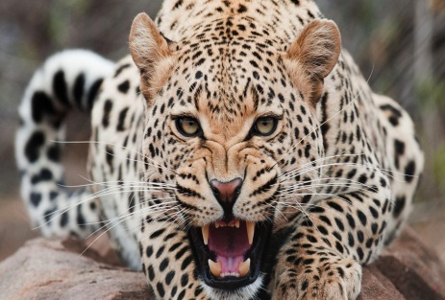
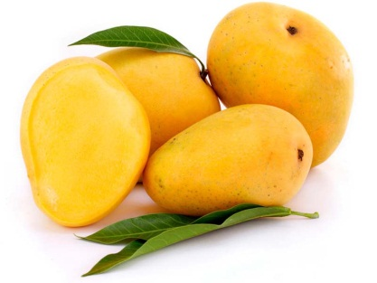

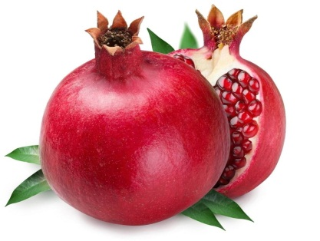

NOMENCLATURE
Certain CONVENTIONS are followed while writing the scientific names :
The NAME OF THE GENUS begins with a CAPITAL LETTER.
For example
Panthera
Mangifera
Rosa
Punica

Slide 12
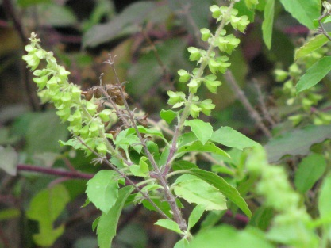
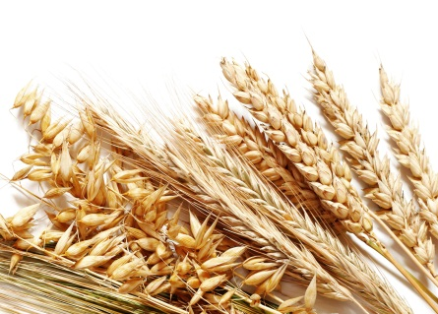
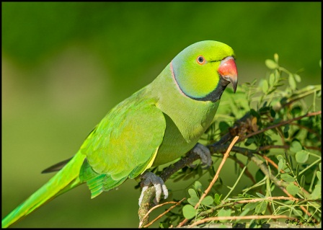
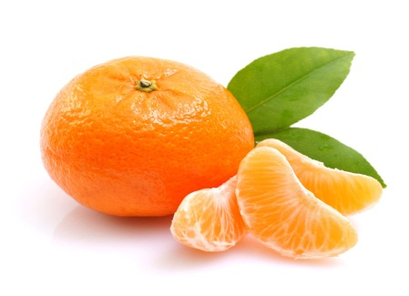
NOMENCLATURE
Certain CONVENTIONS are followed while writing the scientific names :
The name of the SPECIES begins with a SMALL LETTER.
For example
sanctum
aestivum
macaw
aurantium

Slide 13
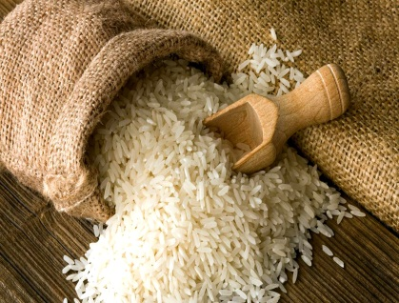
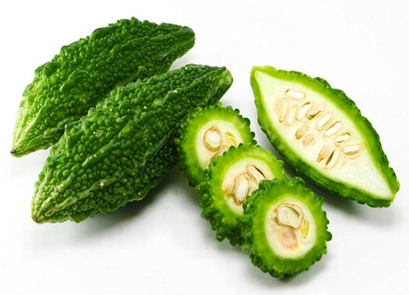
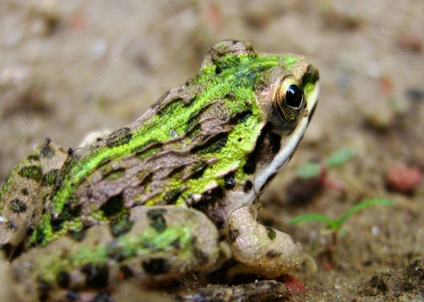
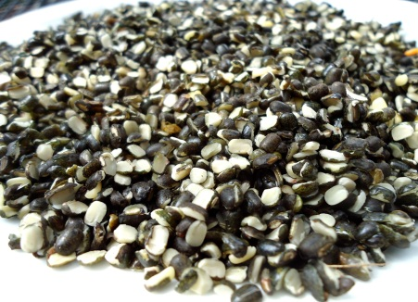
NOMENCLATURE
Certain CONVENTIONS are followed while writing the scientific names :
When PRINTED, the SCIENTIFIC NAME is given in ITALICS.
For example
Oryza sativa
Momordica charantia
Rana tigrina
Vigna mungo

Slide 14
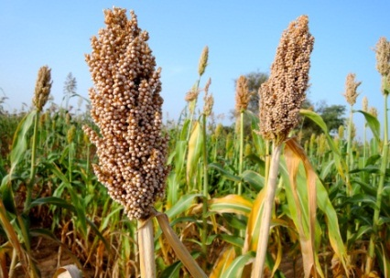
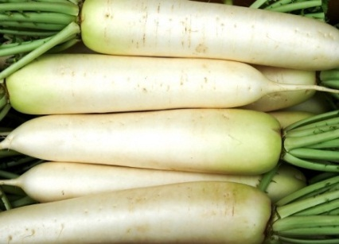

NOMENCLATURE
Certain CONVENTIONS are followed while writing the scientific names :
When WRITTEN BY HAND, the GENUS NAME and THE SPECIES NAME have to be UNDERLINED SEPARATELY.
For example :
Sorghum bicolor
Raphanus sativus

Slide 15
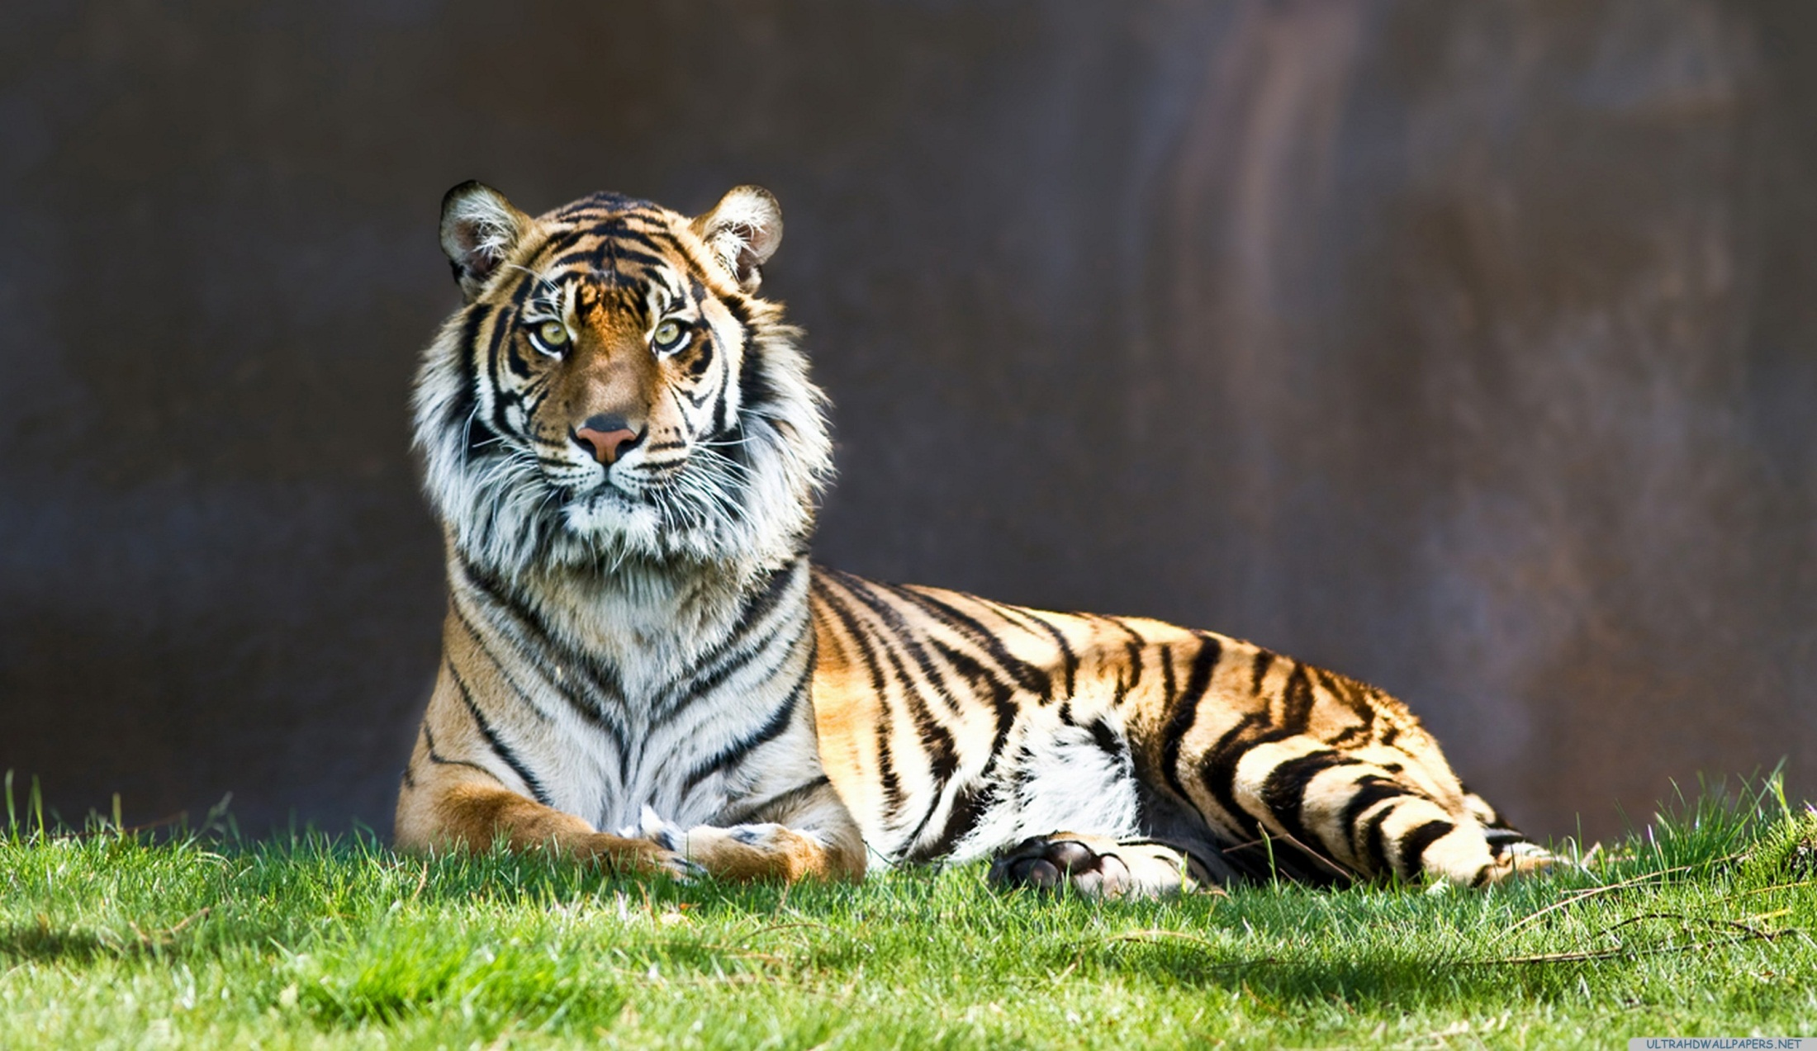
NOMENCLATURE
After learning about these conventions let us see the SCIENTIFIC NAMES of few organisms.
Panthera tigris
The NAME OF THE GENUS begins with a CAPITAL LETTER.
The name of the SPECIES begins with a SMALL LETTER.
When PRINTED, the SCIENTIFIC NAME is given in ITALICS.
When WRITTEN BY HAND, the GENUS NAME and THE SPECIES NAME have to be UNDERLINED SEPARATELY.

Slide 16
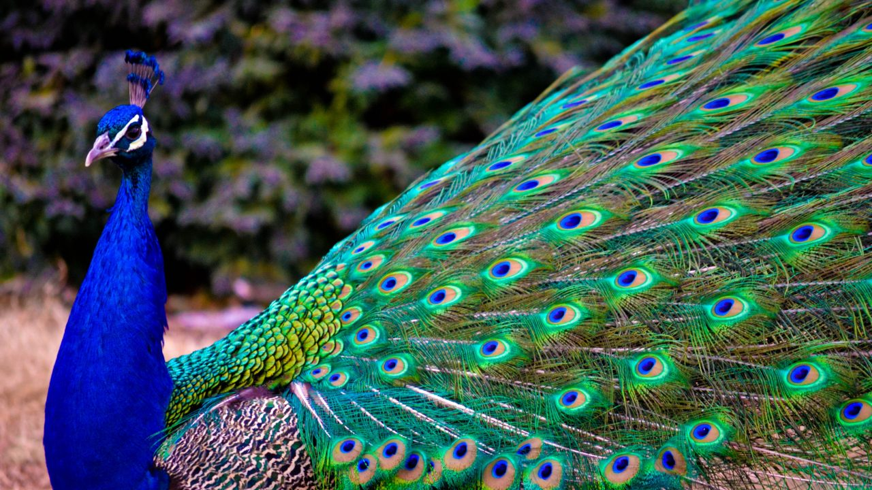
NOMENCLATURE
After learning about these conventions let us see the SCIENTIFIC NAMES of few organisms.
Pavo cristatus

Slide 17
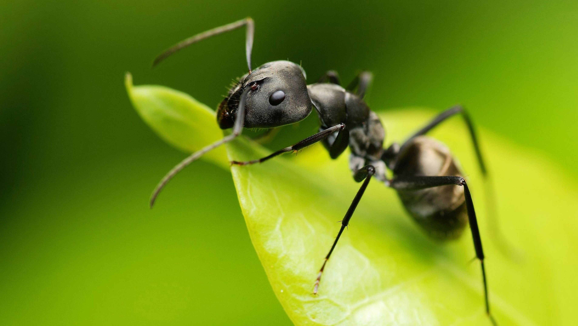
NOMENCLATURE
After learning about these conventions let us see the SCIENTIFIC NAMES of few organisms.
Lasius niger

Slide 18
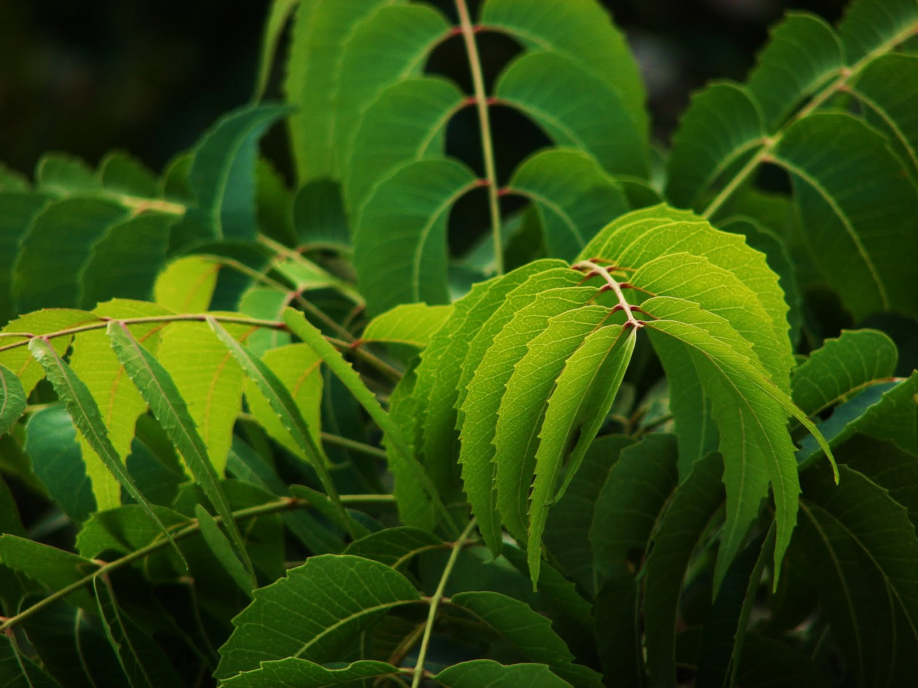
NOMENCLATURE
Azadirachta indica
After learning about these conventions let us see the SCIENTIFIC NAMES of few organisms.

Slide 19

NOMENCLATURE
Nelumbo nucifera
After learning about these conventions let us see the SCIENTIFIC NAMES of few organisms.

Slide 20
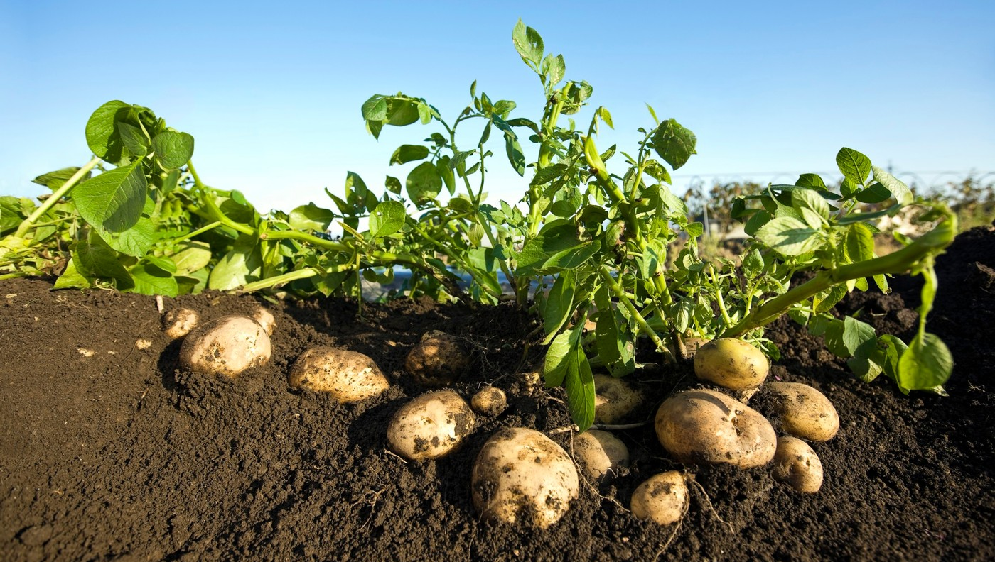
NOMENCLATURE
Solanum tuberosum
After learning about these conventions let us see the SCIENTIFIC NAMES of few organisms.

Slide 21


